Slide 1
Navigation Architecture Component
Android Jetpack

Slide 2
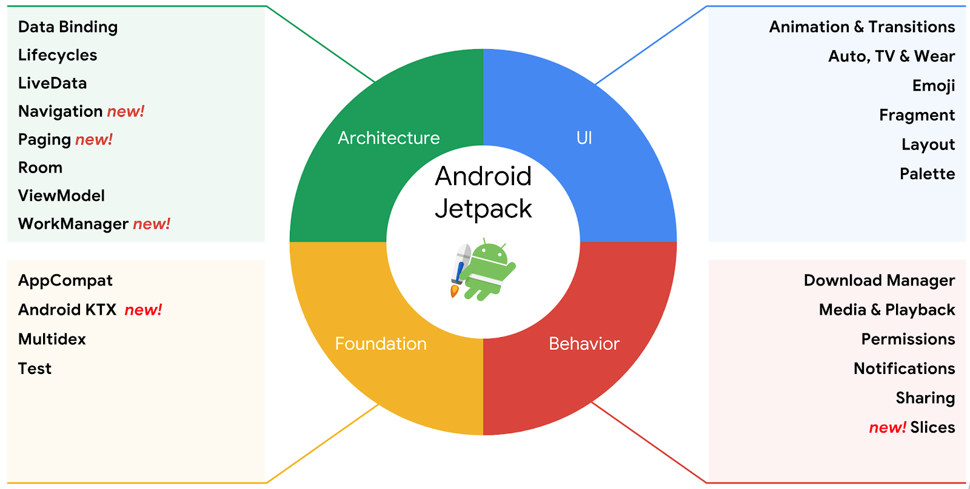
Android Jetpack

Slide 3
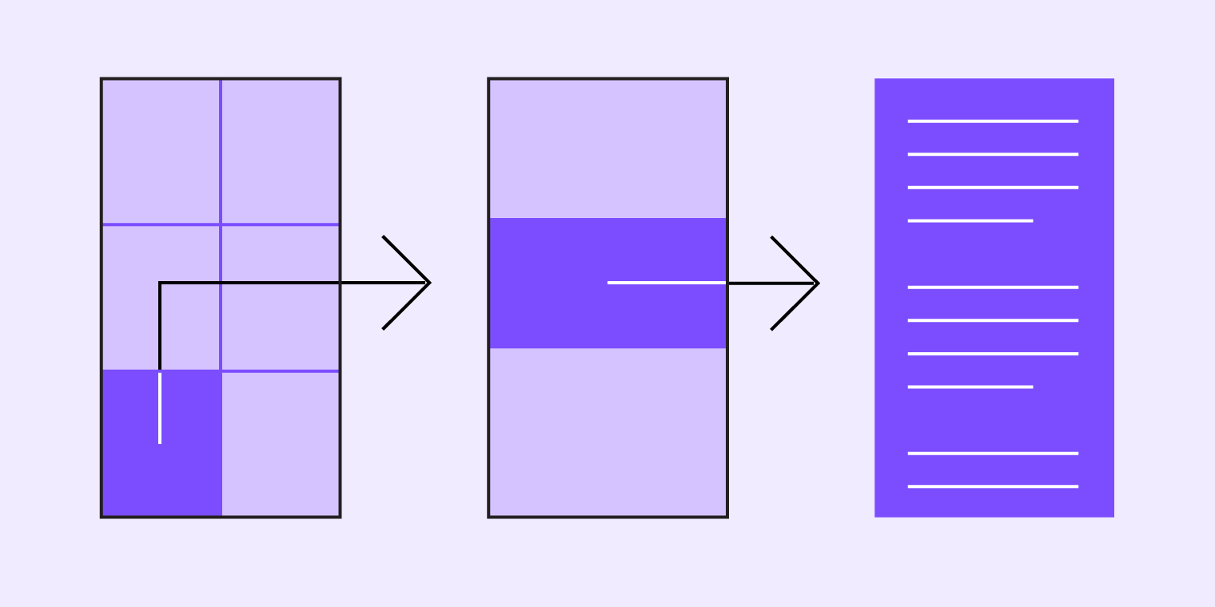
Principles of navigation
The Navigation Architecture Component is based on the following design principles:
Fixed start destination
Navigation state should be represented via a stack of destinations
The Up button never exits your app
Up and Back are identical within your app's task
Deep linking and navigating to a destination should yield the same stack

Slide 4
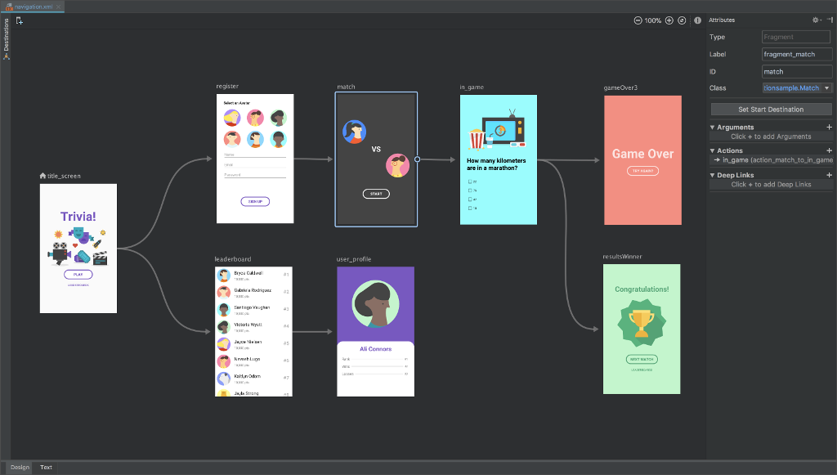
Navigation Component consists of
Navigation Graph (New XML resource)
NavHostFragment (Layout XML view)
NavController (Kotlin/Java object)

Slide 5
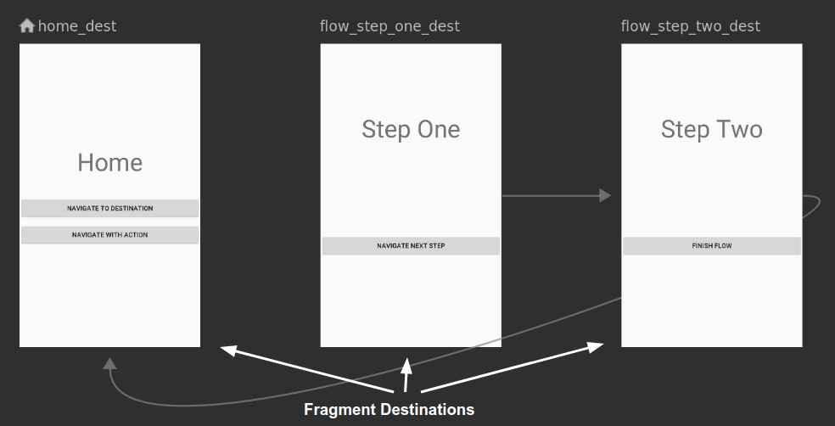
Navigation Graph. Destinations

Slide 6
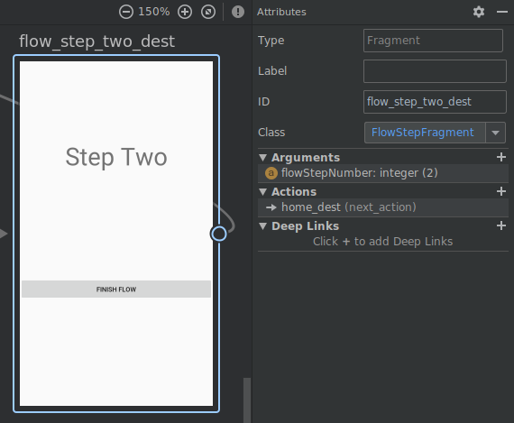
Destinations. Attributes

Slide 7
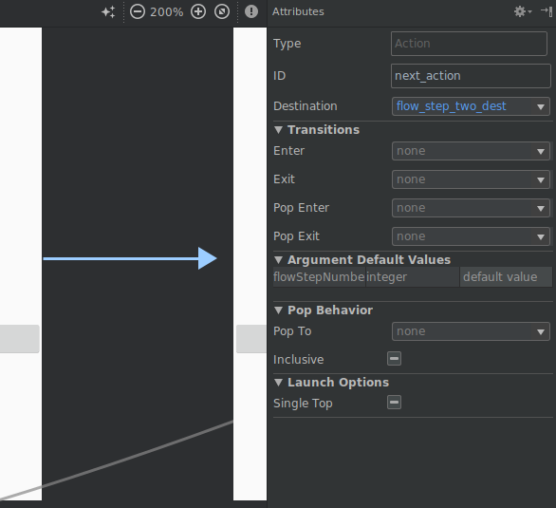
Destinations. Actions

Slide 8
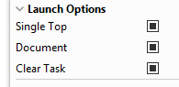
Launch Options

Slide 9
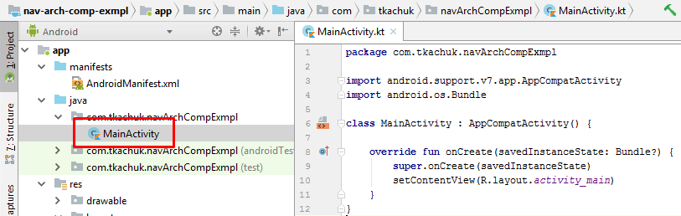
Init project

Slide 10
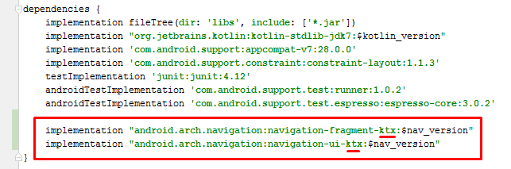
Add dependencies

Slide 11
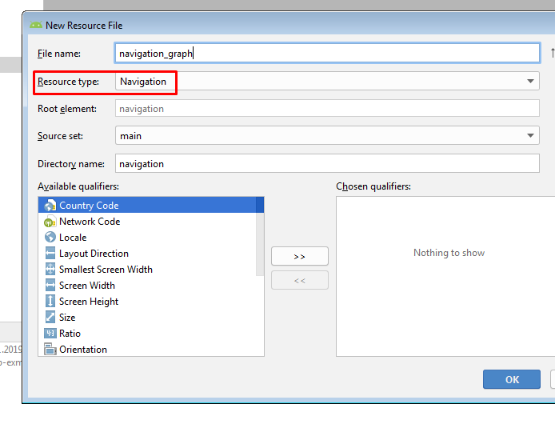
Create navigation graph

Slide 12
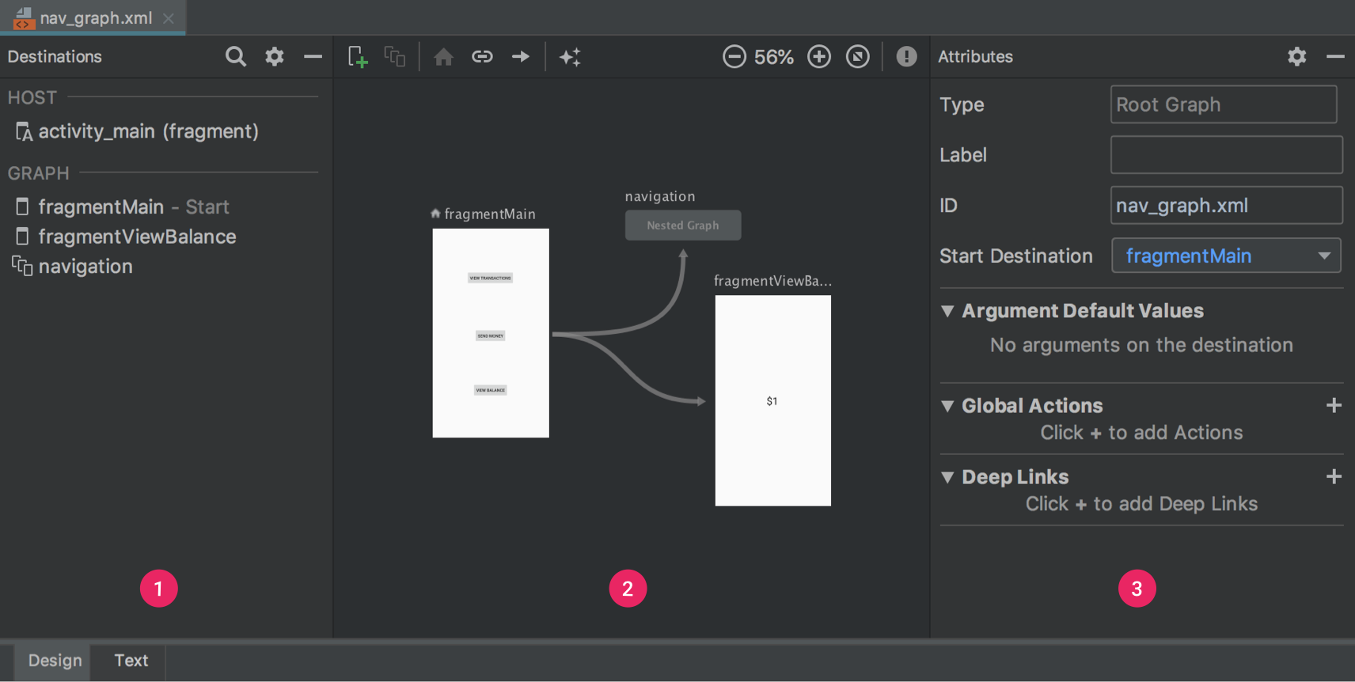
Navigation graph

Slide 13
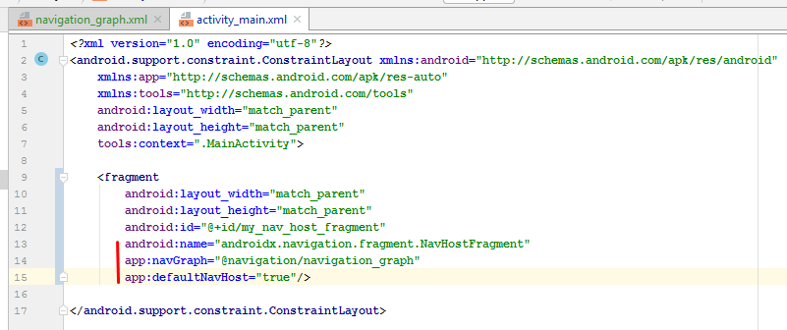
Add host fragment to Main Activity

Slide 14
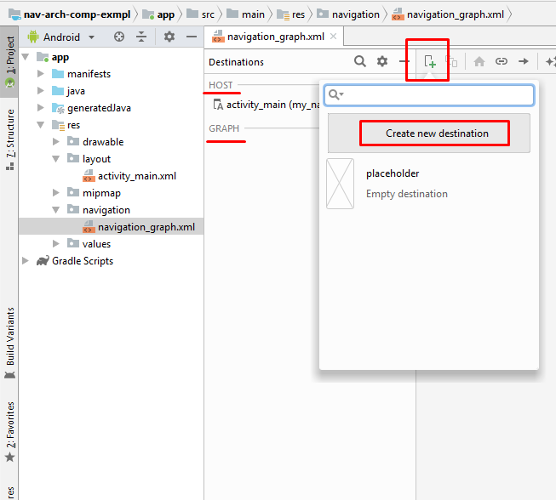
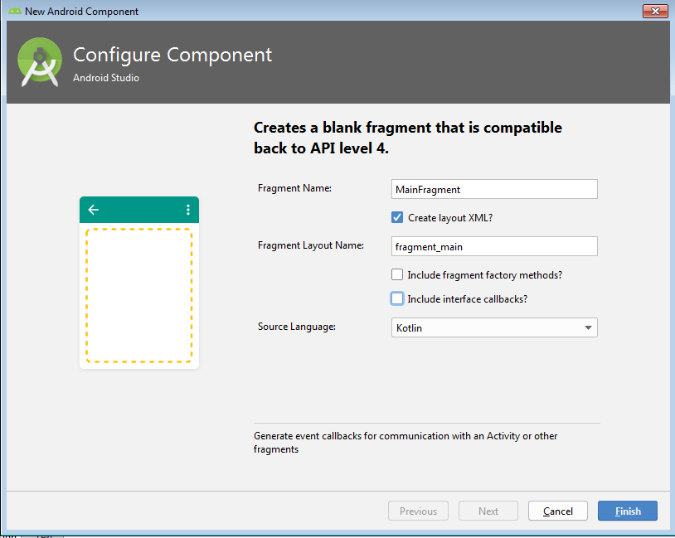
Create new destination

Slide 15
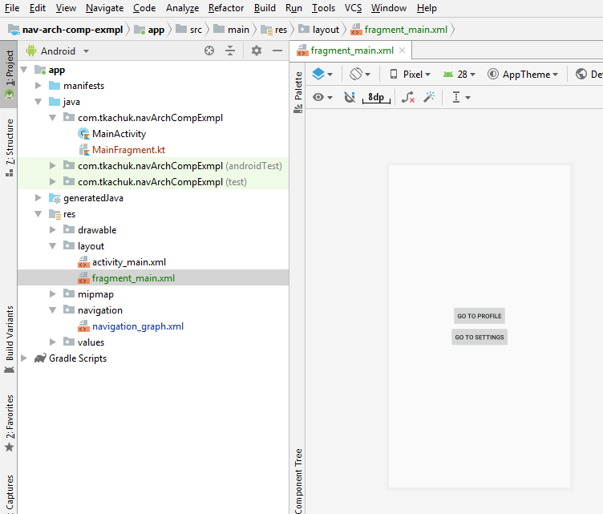
Create UI for Main Fragment

Slide 16
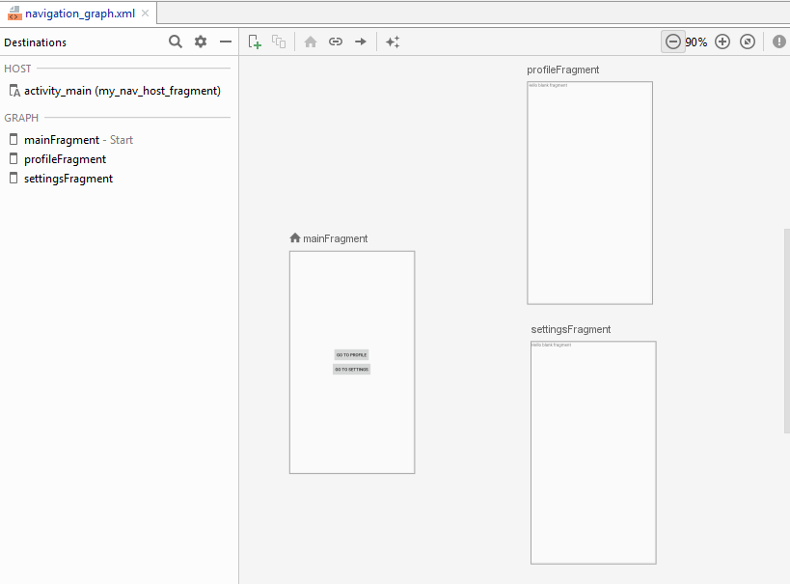
Navigation graph with destinations

Slide 17
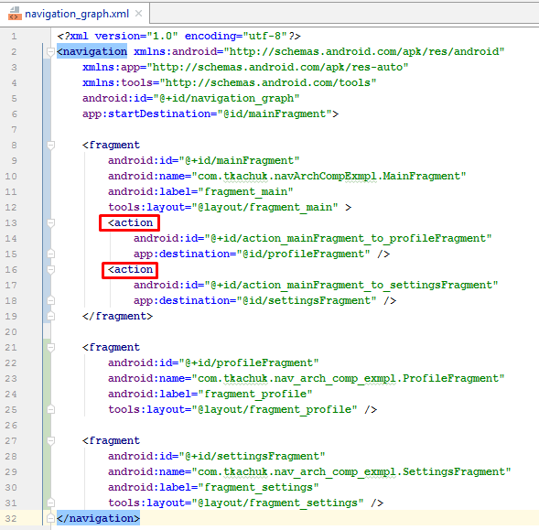
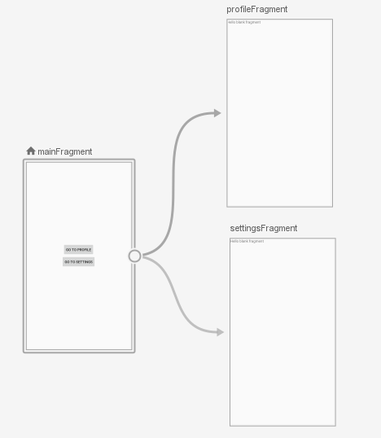
Add actions

Slide 18
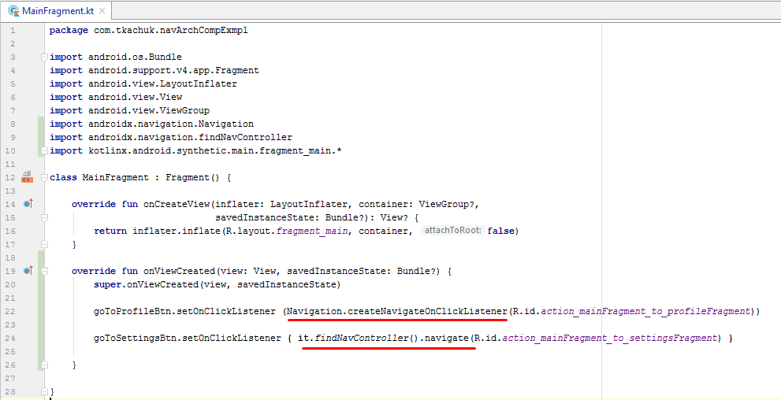
Navigate to another fragment

Slide 19
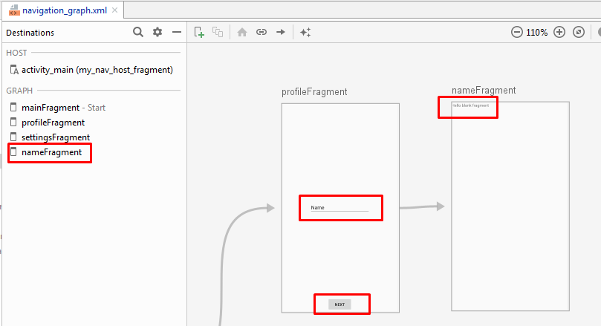
Pass values between fragments

Slide 20
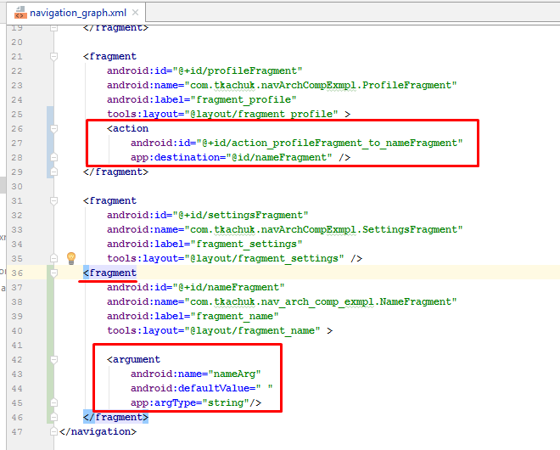
Add argument to destination fragment

Slide 21
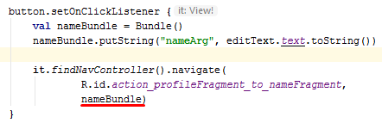
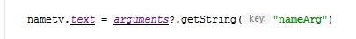
Pass value from Profile fragment to Name fragment
Profile fragment
Name fragment

Slide 22
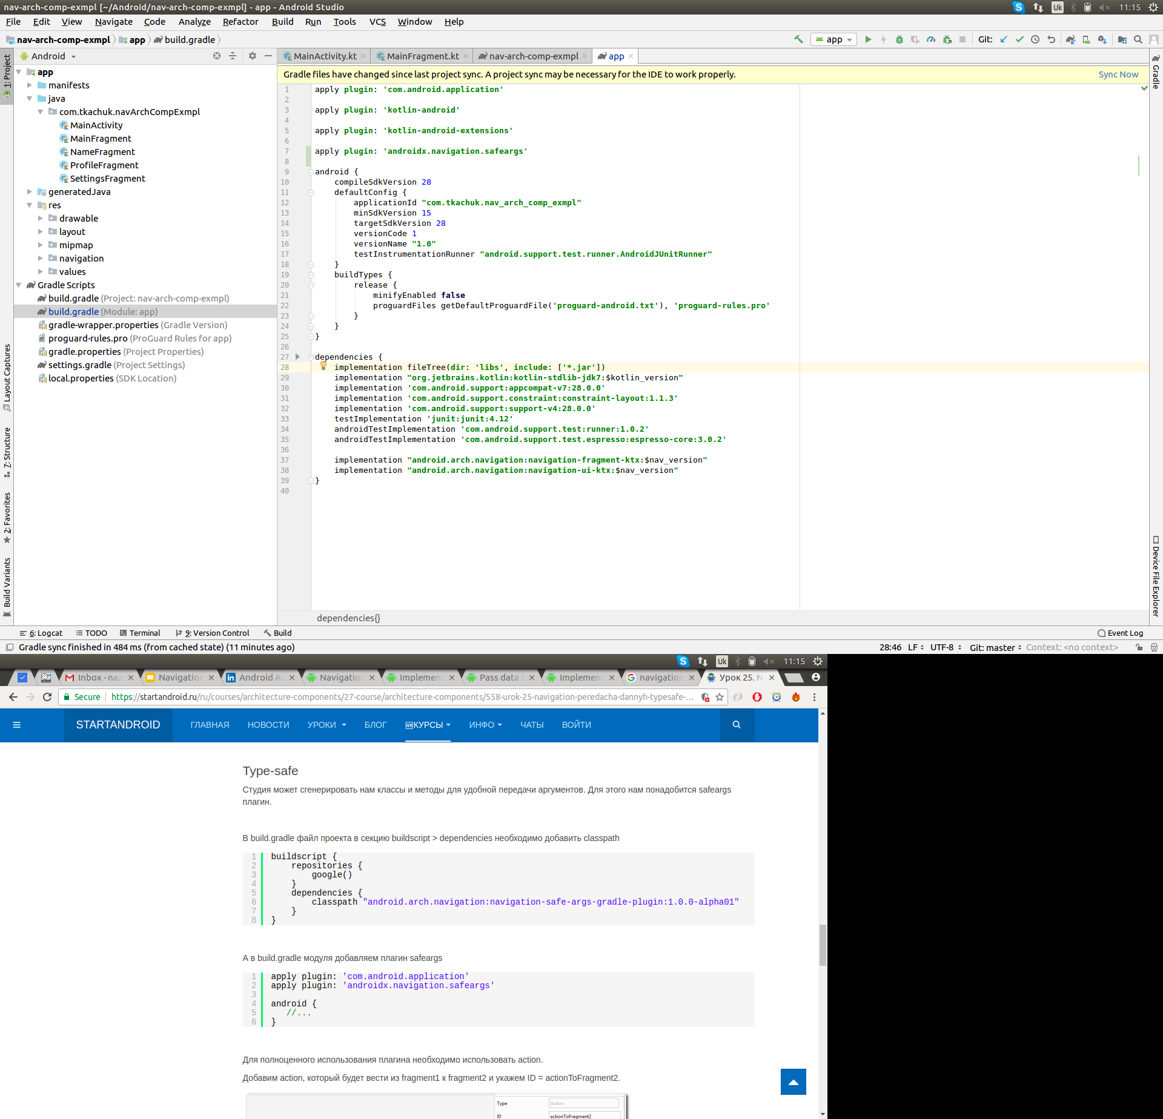
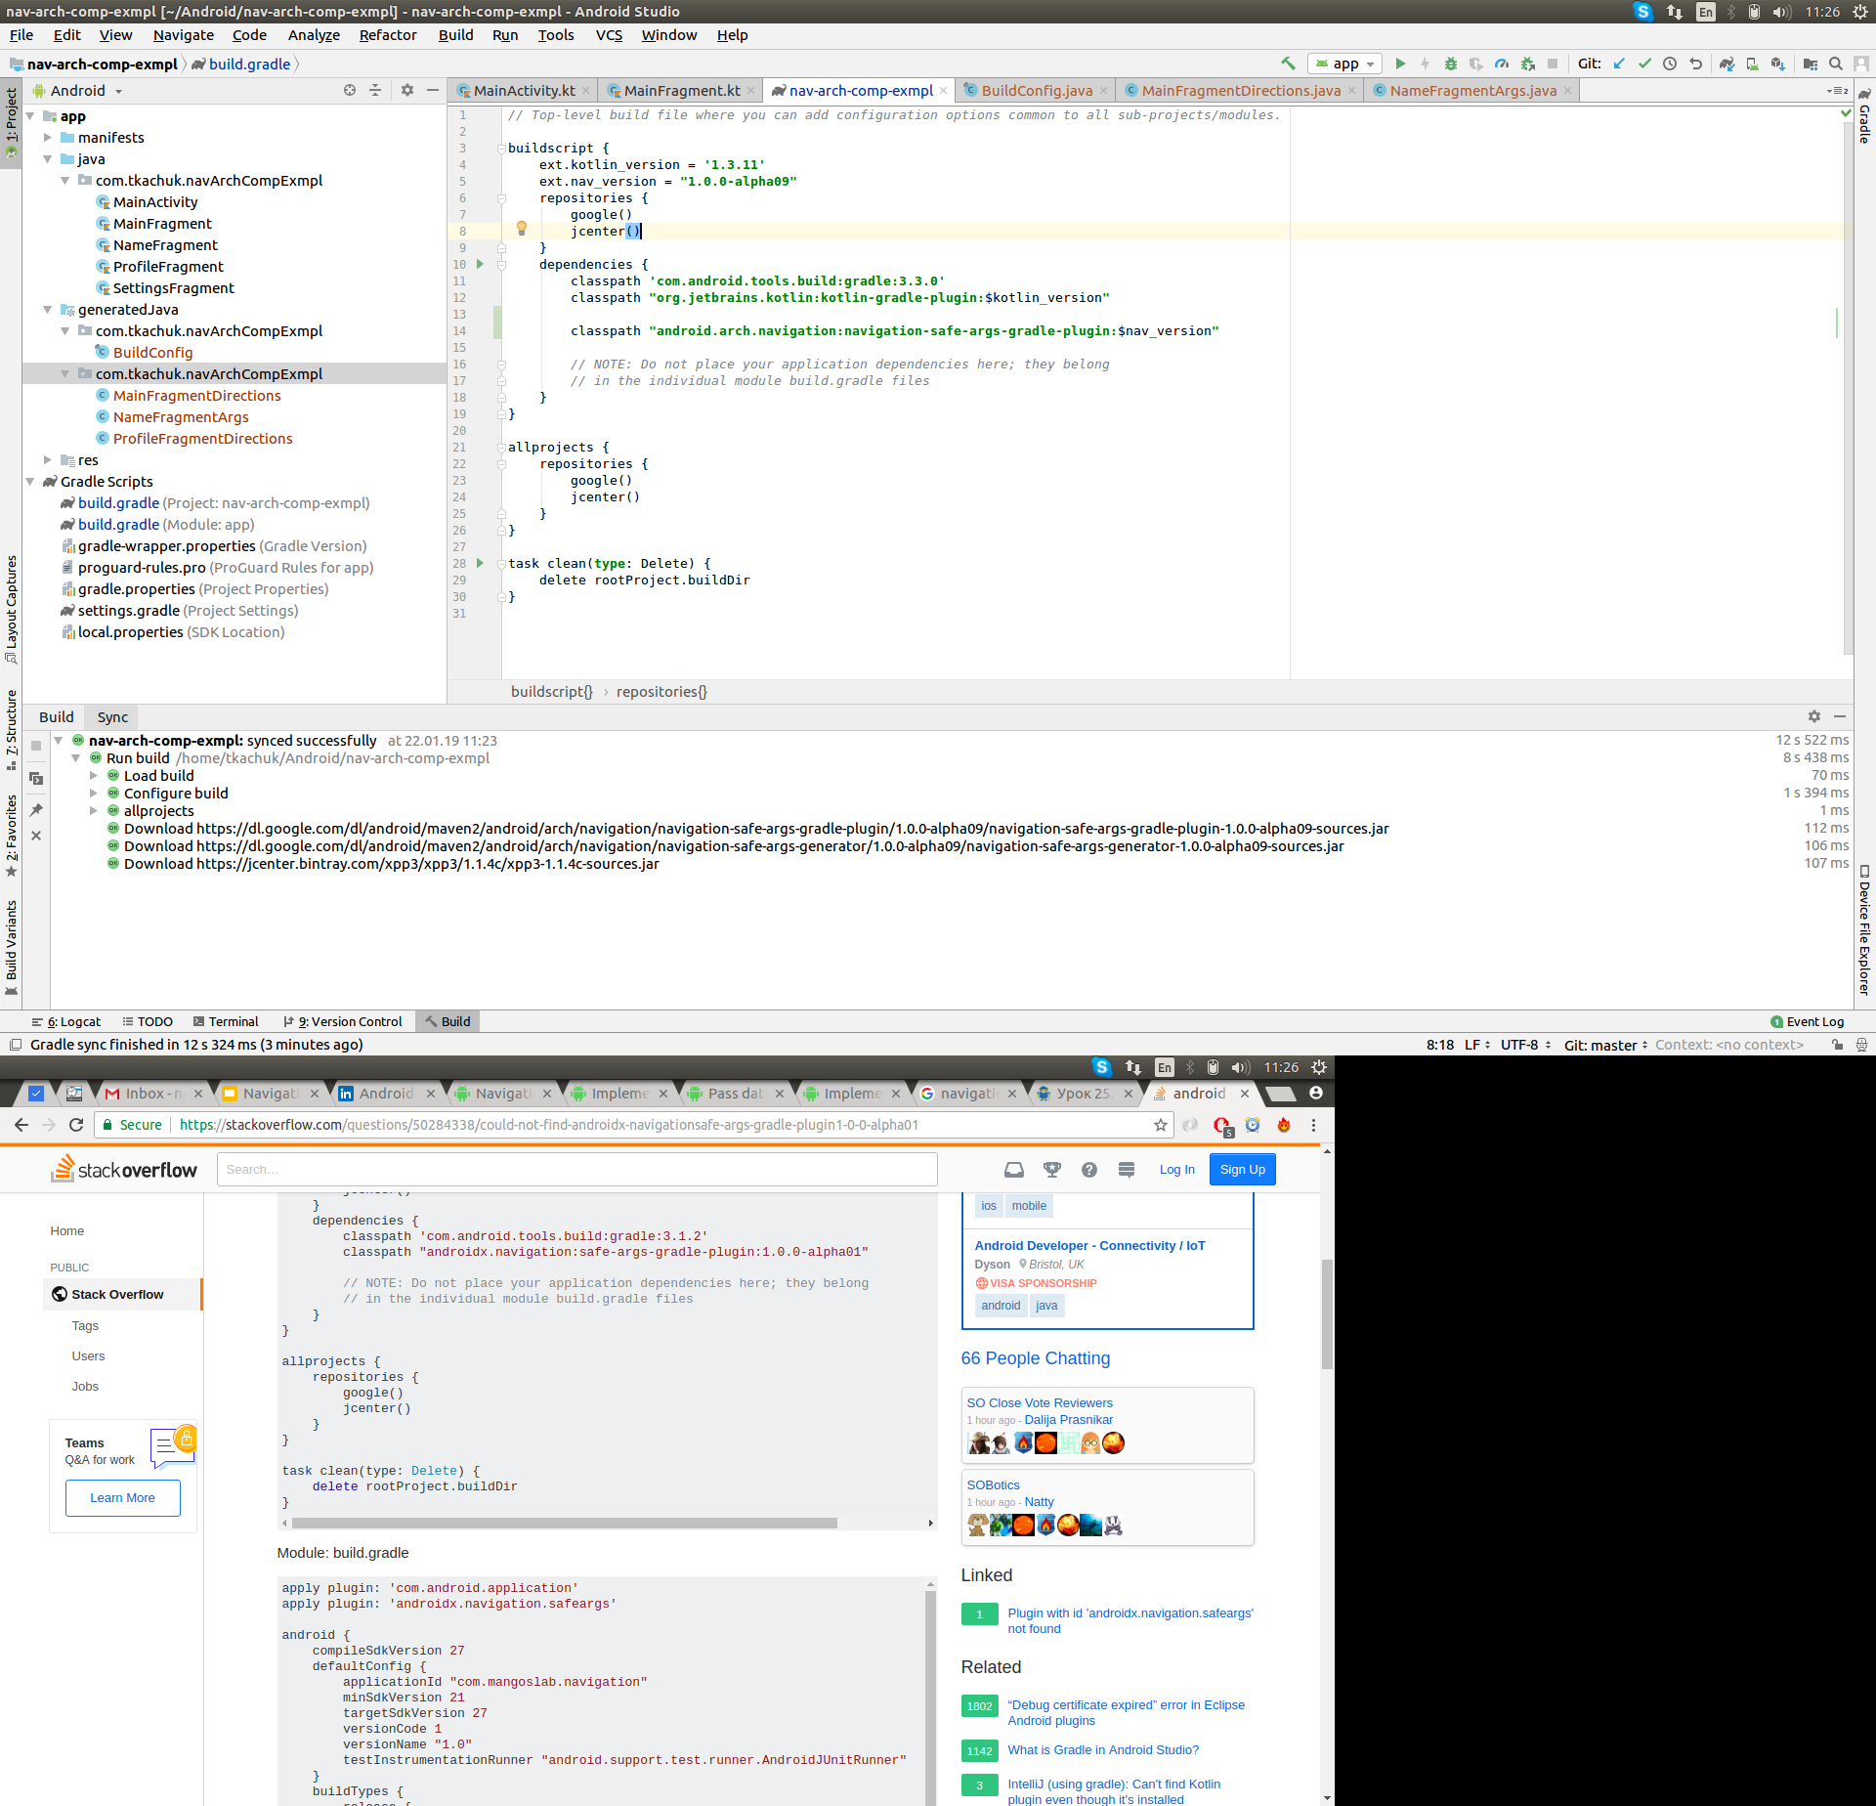
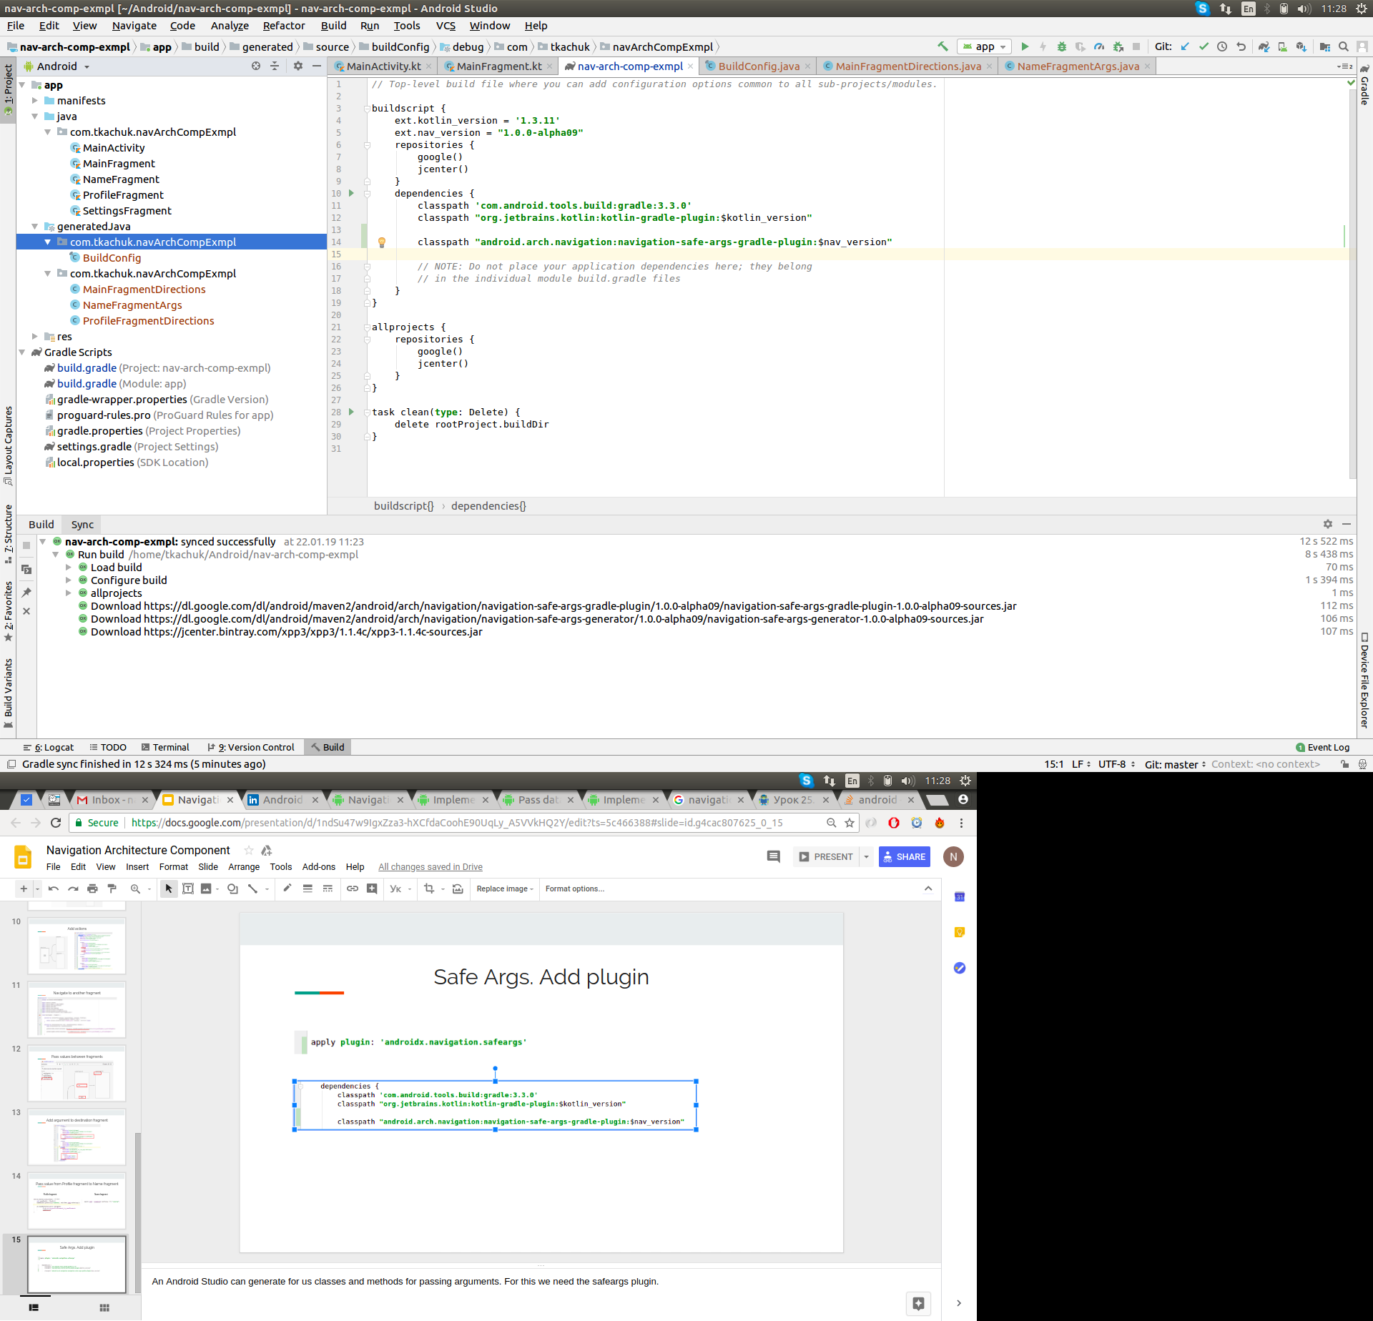
Safe Args. Add plugin
Notes:
An Android Studio can generate for us classes and methods for passing arguments. For this we need the safeargs plugin.

Slide 23
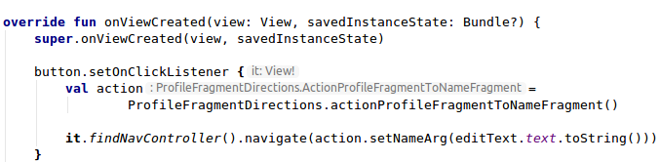
Safe Args
Sender

Slide 24
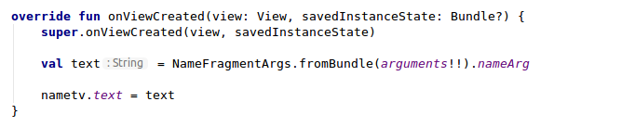
Safe Args
Receiver

Slide 25
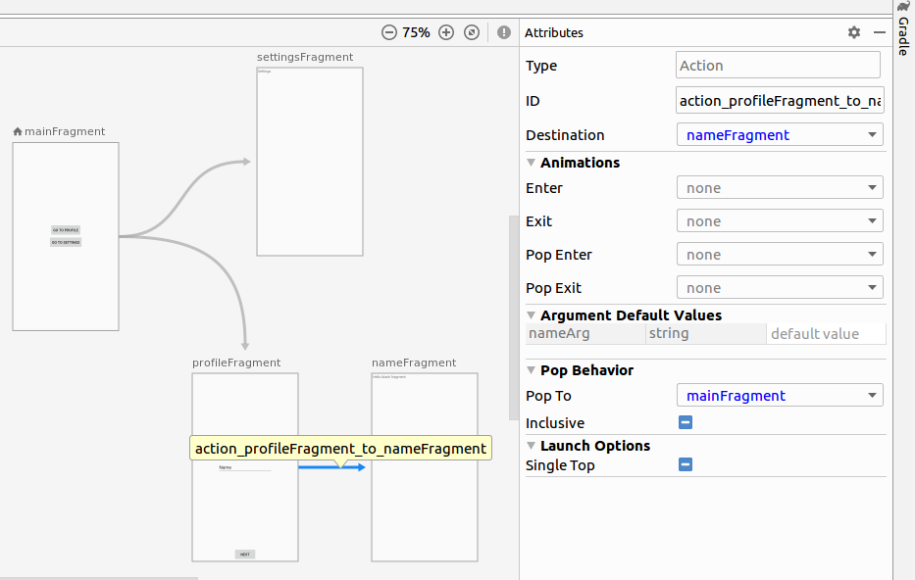
Pop behaviour

Slide 26
Navigation UI

Slide 27
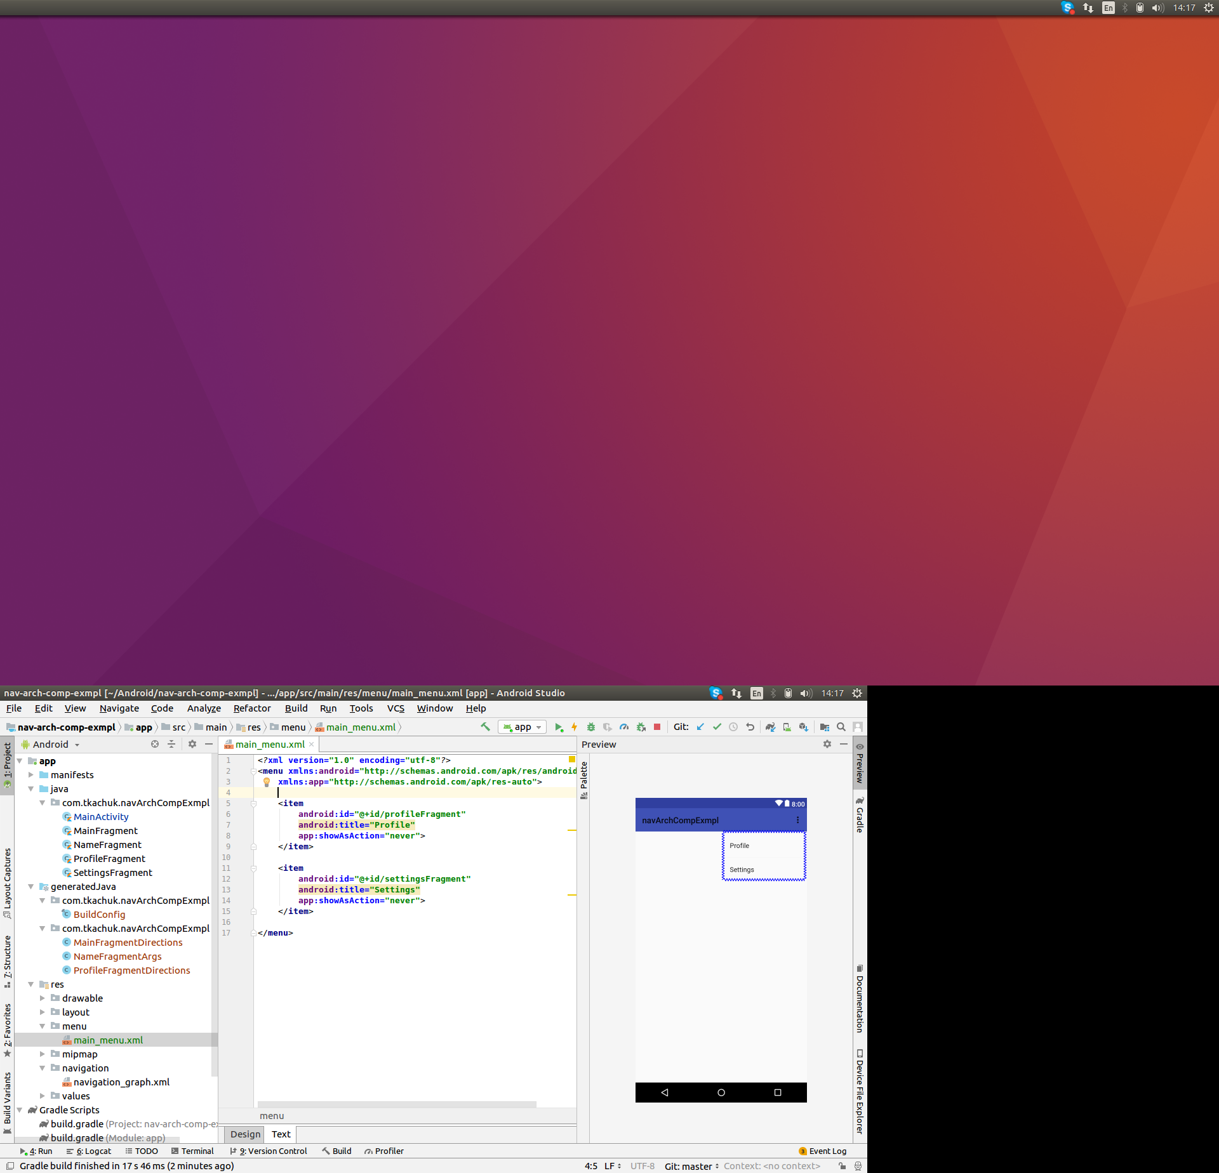
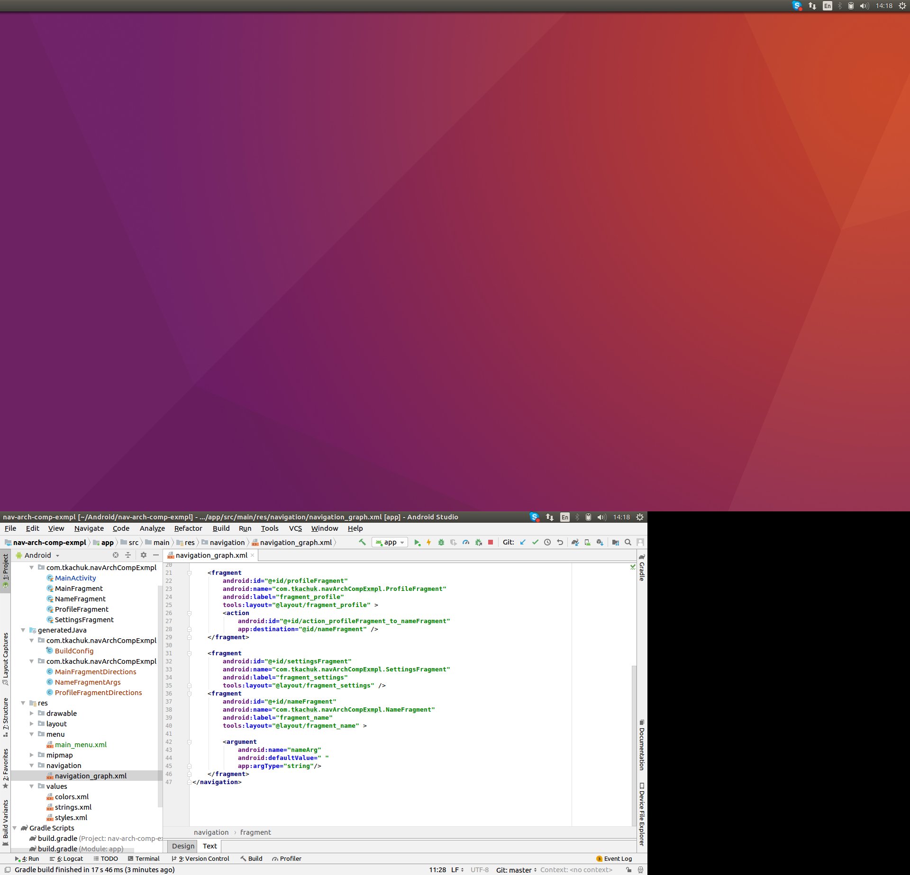
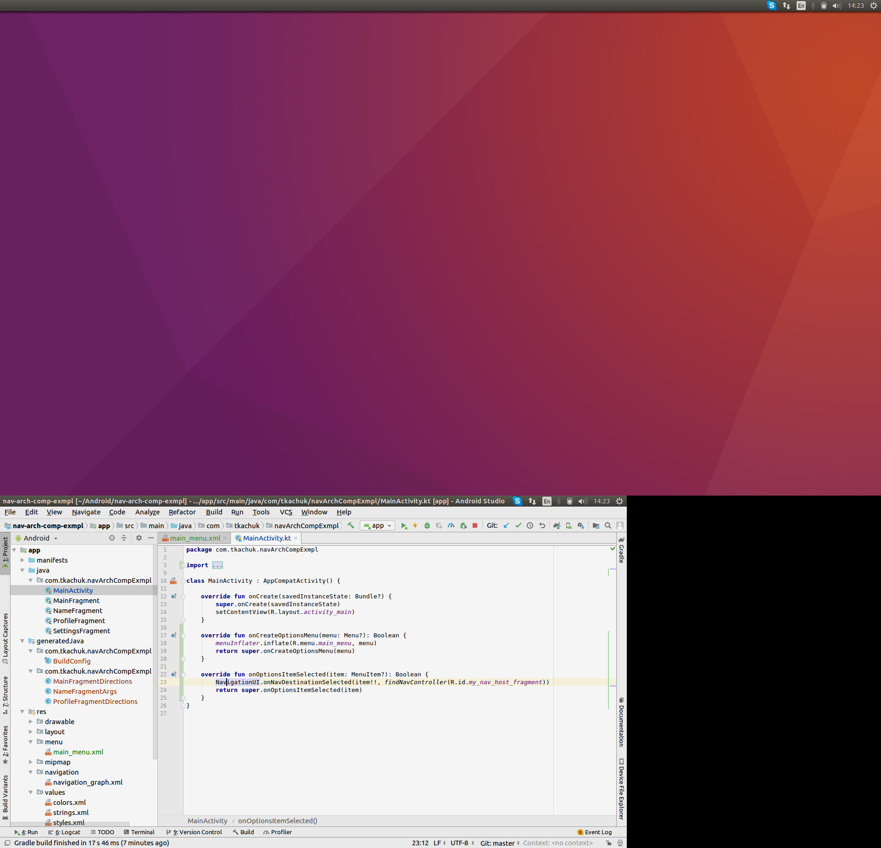
Navigation UI. Menu

Slide 28
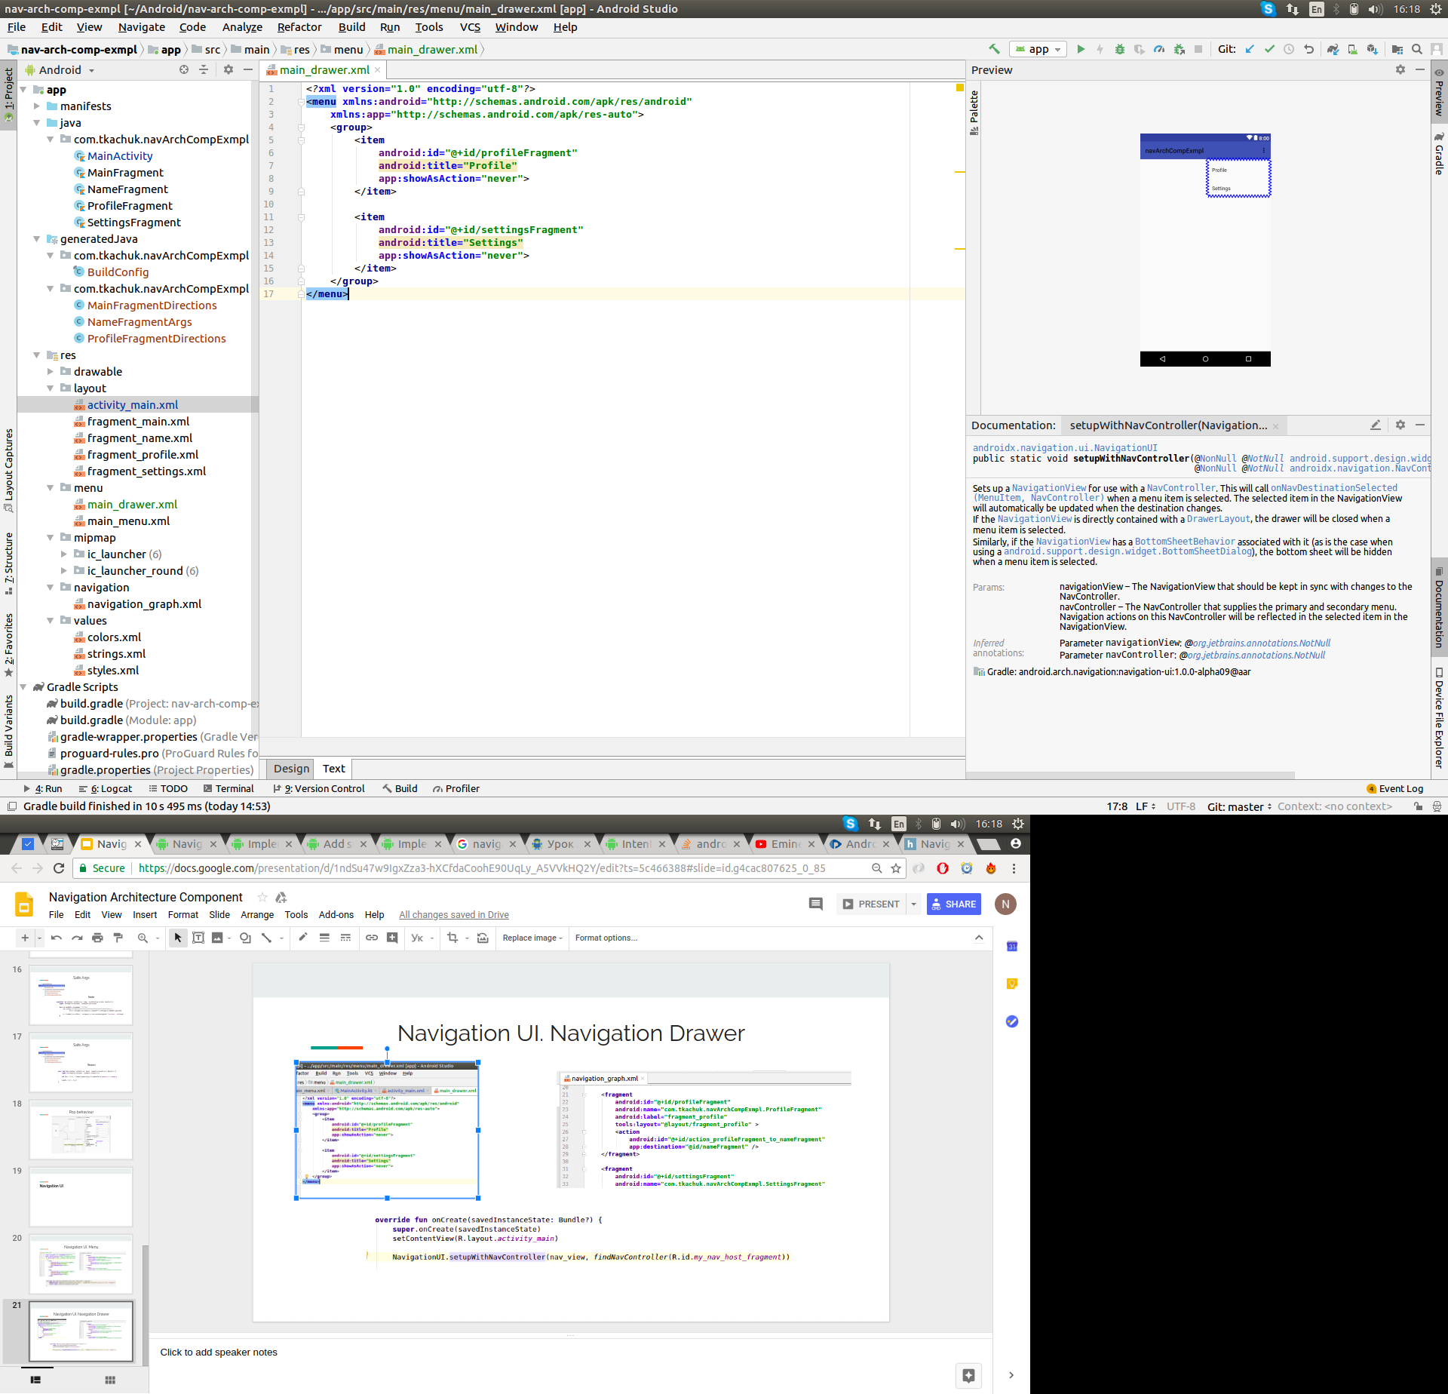
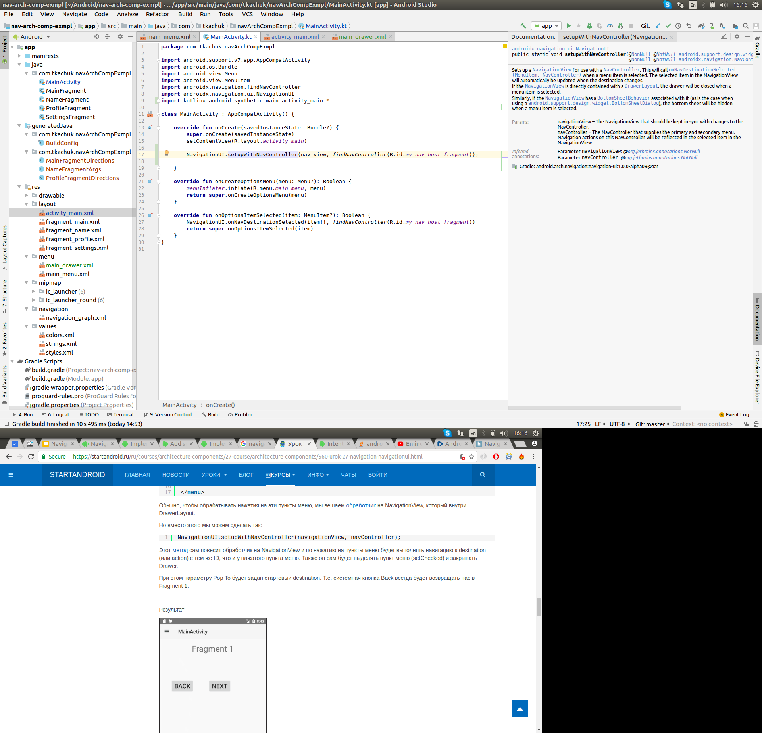
Navigation UI. Navigation Drawer

Slide 29
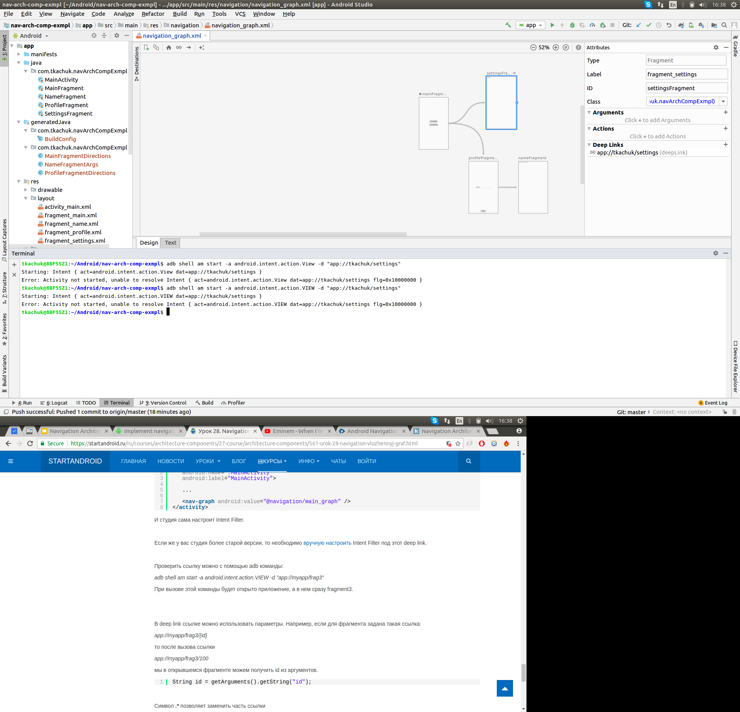
Deep Links

Slide 30
Links
https://habr.com/ru/company/redmadrobot/blog/359282/
https://habr.com/ru/company/hh/blog/358414/
https://startandroid.ru/ru/courses/architecture-components/27-course/architecture-components/559-urok-26-navigation-parametry-navigacii.html
https://codelabs.developers.google.com/codelabs/android-navigation/#1

